Slide 1
面試簡報
面試者：蘇柏丞

Slide 2
01
個人簡介
02
教育性晶片下線經驗
目錄
contents
03
論文介紹
04
其他作品

Slide 3

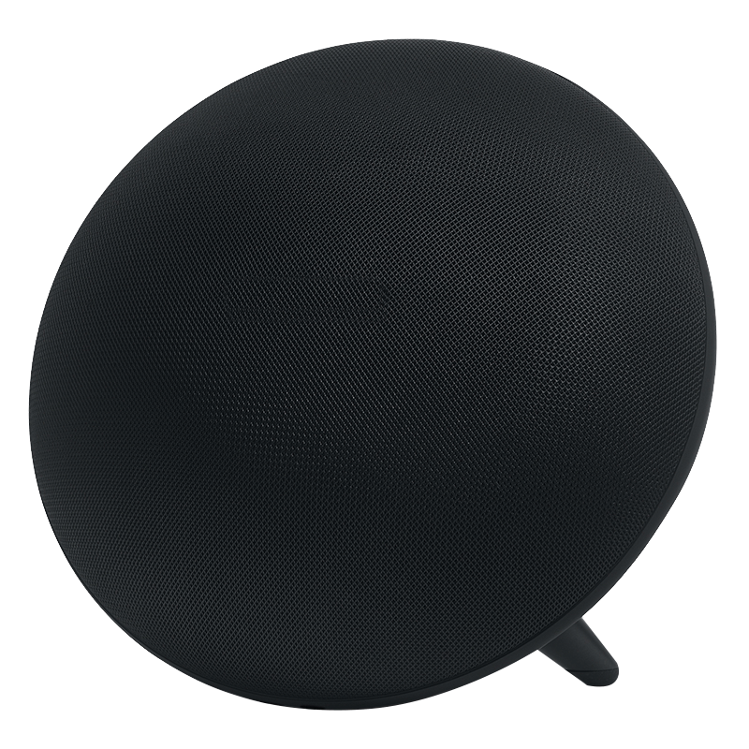
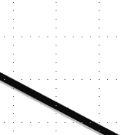
01
個人簡介

Slide 4

個人簡介
姓 名：蘇柏丞
生 日：2001/07/13
信 箱：fossum2523@gmail.com
電 話：0981-933-963
學 歷：臺灣科技大學電子工程學系
指導教授：林銘波教授
實 驗 室：數位積體電路實驗室
經 歷：碩士班榮獲電子所碩士優秀獎學金
第十七屆數位訊號處理創思設計競賽 入圍
相關課程：NTU → 系統晶片設計實驗(A+)、高等數位訊號處理(A+) NTUST → FPGA系統設計實務(A+)、超大型積體電路設計(A+)、 高等計算機演算法(A-) 、超大型積體電路測試(修習中)
04

Slide 5
相關專題
碩士：
碩士論文 - 設計與實現一個相容於AXI-4介面的後量子密碼學ML-DSA之硬體加速器IP
T18晶片下線 - 設計與實現同步AES-128加密IP
SoC 期末專題
16-bit RISC CPU
大學：
T18晶片下線 -設計與實現以CORDIC為基礎之FFT IP
利用ECG完成具身分辨識之血壓計
05

Slide 6
專業技能
程式語言
使用工具
英文能力
Verilog
C
Python
Assembly Language
Design Compiler
IC Compiler
Vivado
VCS
Verdi
NC-Verilog
TOEIC 675
06

Slide 7

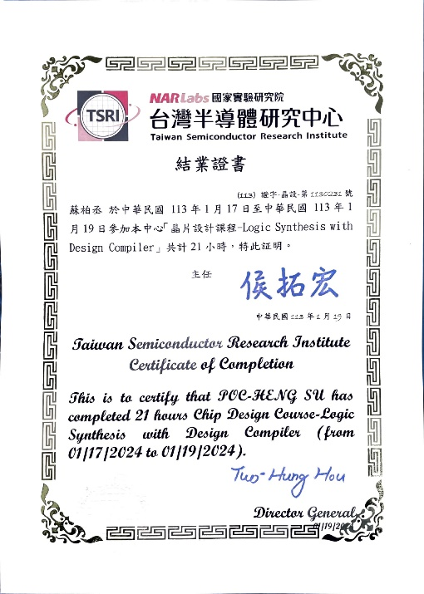
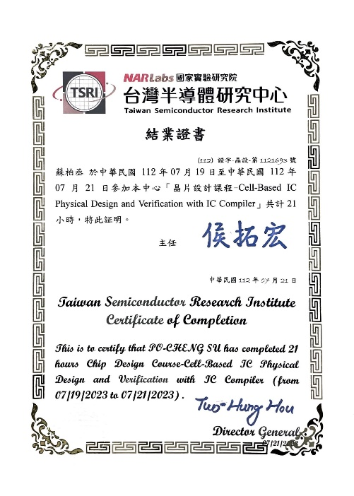
證書
TSRI Cell-Based IC Physical Design and Verification with IC Compiler ( 21 hours )
TSRI Logic Synthesis with Design Compiler ( 21 hours )
07

Slide 8
02
教育性晶片下線經驗

Slide 9






設計與實現同步AES-128加密IP
Symmetric encryption
Mathematical operations are relatively less complicated, lower hardware costs, and faster speed
key
transmission
sender
plaintext
Encrypt
ciphertext
ciphertext
Decrypt
plaintext
recipient
9

Slide 10

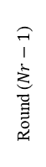
AES-128 Algorithm
Plaintext
Key
Key Expansion
AddRoundKey
W[0, 3]
Round 1
SubBytes
AES-128
Key size | 128 bits
Plaintext block size | 128 bits
Number of rounds | 10
Round key size | 128 bits
Number of expanded keys | 44
ShiftRows
MixColumns
AddRoundKey
W[4, 7]
…
Round ($Nr−1$)
SubBytes
ShiftRows
Two important parts：
Key expansion
Message encryption
MixColumns
AddRoundKey
W[4(Nr-1), 4(Nr-1)+3]
Round $N$r
SubBytes
ShiftRows
AddRoundKey
W[4Nr, 4Nr+3]
Ciphertext
10

Slide 11
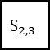
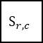
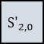
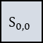
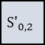
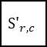
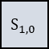

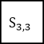
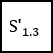
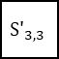

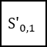
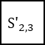
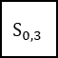
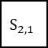
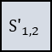
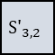
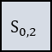
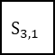
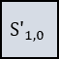
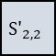
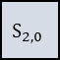
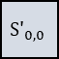
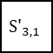
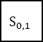
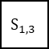
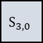
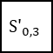
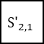
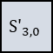
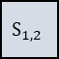
AES-128 Algorithm – Substitute Bytes
Way-1 Look-up Functionality
S-box |  | Column
 |  | 0 | 1 | 2 | 3 | 4 | 5 | 6 | 7 | 8 | 9 | a | b | c | d | e | f
Row | 0 | 63 | 7c | 77 | 7b | f2 | 6b | 6f | c5 | 30 | 01 | 67 | 2b | fe | d7 | ab | 76
 | 1 | ca | 82 | c9 | 7d | fa | 59 | 47 | f0 | ad | d4 | a2 | af | 9c | a4 | 72 | c0
 | 2 | b7 | fd | 93 | 26 | 36 | 3f | f7 | cc | 34 | a5 | e5 | f1 | 71 | d8 | 31 | 15
 | 3 | 04 | c7 | 23 | c3 | 18 | 96 | 05 | 9a | 07 | 12 | 80 | e2 | eb | 27 | b2 | 75
 | 4 | 09 | 83 | 2c | 1a | 1b | 6e | 5a | a0 | 52 | 3b | d6 | b3 | 29 | e3 | 2f | 84
 | 5 | 53 | d1 | 00 | ed | 20 | fc | b1 | 5b | 6a | cb | be | 39 | 4a | 4c | 58 | cf
 | 6 | d0 | ef | aa | fb | 43 | 4d | 33 | 85 | 45 | f9 | 02 | 7f | 50 | 3c | 9f | a8
 | 7 | 51 | a3 | 40 | 8f | 92 | 9d | 38 | f5 | bc | b6 | da | 21 | 10 | ff | f3 | d2
 | 8 | cd | 0c | 13 | ec | 5f | 97 | 44 | 17 | c4 | a7 | 7e | 3d | 64 | 5d | 19 | 73
 | 9 | 60 | 81 | 4f | dc | 22 | 2a | 90 | 88 | 46 | ee | b8 | 14 | de | 5e | 0b | db
 | a | e0 | 32 | 3a | 0a | 49 | 06 | 24 | 5c | c2 | d3 | ac | 62 | 91 | 95 | e4 | 79
 | b | e7 | c8 | 37 | 6d | 8d | d5 | 4e | a9 | 6c | 56 | f4 | ea | 65 | 7a | ae | 08
 | c | ba | 78 | 25 | 2e | 1c | a6 | b4 | c6 | e8 | dd | 74 | 1f | 4b | bd | 8b | 8a
 | d | 70 | 3e | b5 | 66 | 48 | 03 | f6 | 0e | 61 | 35 | 57 | b9 | 86 | c1 | 1d | 9e
 | e | e1 | f8 | 98 | 11 | 69 | d9 | 8e | 94 | 9b | 1e | 87 | e7 | ce | 55 | 28 | df
 | f | 8c | a1 | 89 | 0d | bf | e6 | 42 | 68 | 41 | 99 | 2d | 0f | b0 | 54 | bb | 16
Direct Logical Mapping
$$S_{0,0}$$
$$S_{0,1}$$
$$S_{0,2}$$
$$S_{0,3}$$
S-Box
$${S′}_{0,0}$$
$${S′}_{0,1}$$
$${S′}_{0,2}$$
$${S′}_{0,3}$$
$$S_{1,0}$$
$$S_{r,c}$$
$$S_{1,2}$$
$$S_{1,3}$$
$${S′}_{1,0}$$
$${S′}_{r,c}$$
$${S′}_{1,2}$$
$${S′}_{1,3}$$
$$S_{2,0}$$
$$S_{2,1}$$
$$S_{2,2}$$
$$S_{2,3}$$
$${S′}_{2,0}$$
$${S′}_{2,1}$$
$${S′}_{2,2}$$
$${S′}_{2,3}$$
$$S_{3,0}$$
$$S_{3,1}$$
$$S_{3,2}$$
$$S_{3,3}$$
$${S′}_{3,0}$$
$${S′}_{3,1}$$
$${S′}_{3,2}$$
$${S′}_{3,3}$$
Y
S_{(r , c)}
S-box
b7 | b6 | b5 | b4 | b3 | b2 | b1 | b0
X
X
Y
11

Slide 12
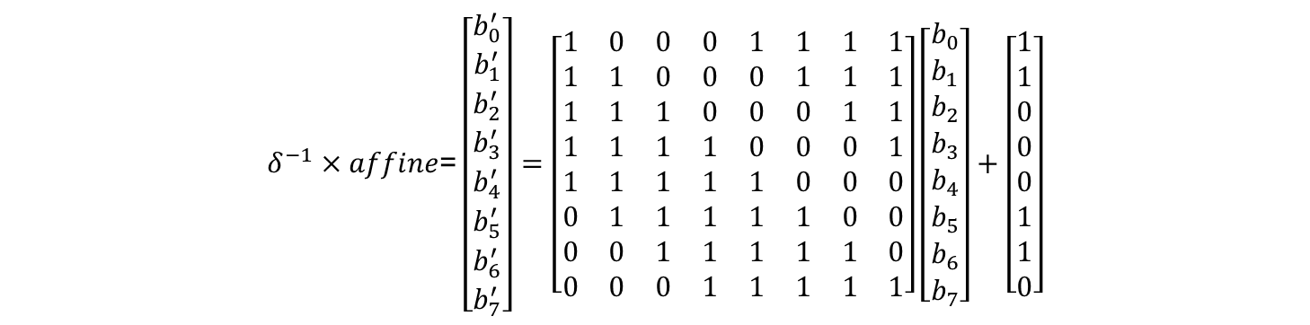
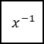
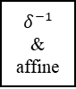
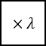

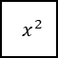

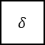

AES-128 Algorithm – Substitute Bytes
Way-2 Composite Field Operation
Multiplicative Inverse + Affine Transformation
4
$$x^{2}$$
$$×λ$$
$$×$$
4
8
$$δ$$
$$x^{−1}$$
8
$$δ^{−1}$$
&
affine
8
data_in
data_out
4
$$×$$
$$×$$
4
$$δ^{−1}×\text{affine}\text{=}\left[\begin{matrix}b_{0}^{′} \\ b_{1}^{′} \\ b_{2}^{′} \\ b_{3}^{′} \\ b_{4}^{′} \\ b_{5}^{′} \\ b_{6}^{′} \\ b_{7}^{′}\end{matrix}\right]=\left[\begin{matrix}1 & 0 & 0 & 0 & 1 & 1 & 1 & 1 \\ 1 & 1 & 0 & 0 & 0 & 1 & 1 & 1 \\ 1 & 1 & 1 & 0 & 0 & 0 & 1 & 1 \\ 1 & 1 & 1 & 1 & 0 & 0 & 0 & 1 \\ 1 & 1 & 1 & 1 & 1 & 0 & 0 & 0 \\ 0 & 1 & 1 & 1 & 1 & 1 & 0 & 0 \\ 0 & 0 & 1 & 1 & 1 & 1 & 1 & 0 \\ 0 & 0 & 0 & 1 & 1 & 1 & 1 & 1\end{matrix}\right]\left[\begin{matrix}b_{0} \\ b_{1} \\ b_{2} \\ b_{3} \\ b_{4} \\ b_{5} \\ b_{6} \\ b_{7}\end{matrix}\right]+\left[\begin{matrix}1 \\ 1 \\ 0 \\ 0 \\ 0 \\ 1 \\ 1 \\ 0\end{matrix}\right]$$
12

Slide 13
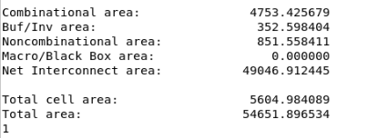
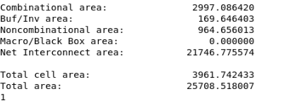
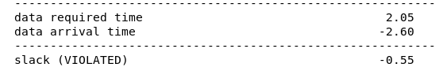
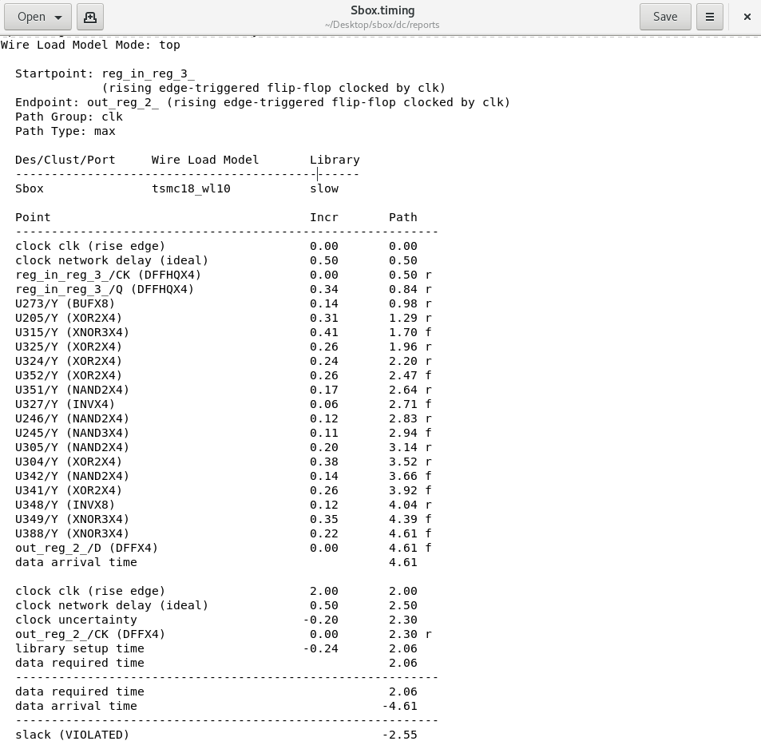

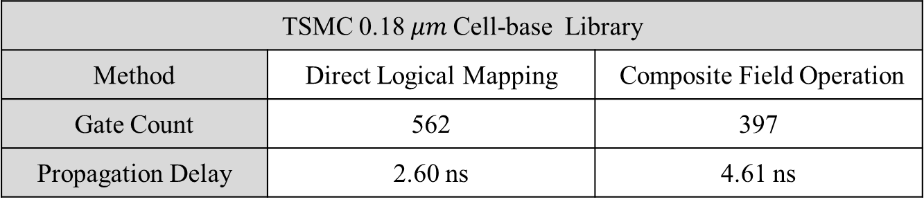
AES-128 Algorithm – Substitute Bytes
Direct Logical Mapping：
Area
Timing
Composite Field Operation：
Area
Timing
TSMC 0.18$μm$ Cell-base Library
Method | Direct Logical Mapping | Composite Field Operation
Gate Count | 562 | 397
Propagation Delay | 2.60 ns | 4.61 ns
13

Slide 14
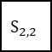
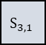
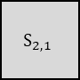
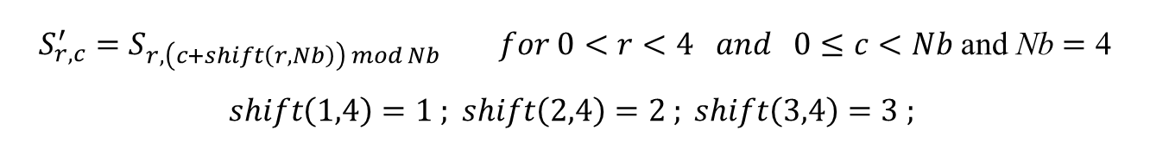






















AES-128 Algorithm – Shift Rows
$$S_{r,c}^{′}=S_{r,\left(c+shift\left(r,Nb\right)\right) mod Nb} for 0<r<4 and 0≤c<Nb \text{and} \text{Nb}=\text{4}$$
$$shift\left(1,4\right)=1 ; shift\left(2,4\right)=2 ; shift\left(3,4\right)=3 ;$$
ShiftRows ()
$$S_{0,0}$$
$$S_{0,1}$$
$$S_{0,2}$$
$$S_{0,3}$$
$$S_{0,0}$$
$$S_{0,1}$$
$$S_{0,2}$$
$$S_{0,3}$$
$$S_{1,0}$$
$$S_{1,1}$$
$$S_{1,2}$$
$$S_{1,3}$$
$$S_{1,1}$$
$$S_{1,2}$$
$$S_{1,3}$$
$$S_{1,0}$$
$$S_{2,0}$$
$$S_{2,1}$$
$$S_{2,2}$$
$$S_{2,3}$$
$$S_{2,2}$$
$$S_{2,3}$$
$$S_{2,0}$$
$$S_{2,1}$$
$$S_{3,0}$$
$$S_{3,1}$$
$$S_{3,2}$$
$$S_{3,3}$$
$$S_{3,3}$$
$$S_{3,0}$$
$$S_{3,1}$$
$$S_{3,2}$$
14

Slide 15

































AES Algorithm – Mix Columns
$$a\left(x\right)=\left\{03\right\}x^{3}+\left\{01\right\}x^{2}+\left\{01\right\}x+\left\{02\right\}$$
$$S′\left(x\right)=a\left(x\right) ⨂ S\left(x\right)$$
$$\left[\begin{aligned}{S′}_{0,c} \\ {S′}_{1,c} \\ {S′}_{2,c} \\ {S′}_{3,c}\end{aligned}\right]=\left[\begin{aligned}02 \\ 01 \\ 01 \\ 03\end{aligned} \begin{aligned}03 \\ 02 \\ 01 \\ 01\end{aligned} \begin{aligned}01 \\ 03 \\ 02 \\ 01\end{aligned} \begin{aligned}01 \\ 01 \\ 03 \\ 02\end{aligned}\right]\left[\begin{aligned}S_{0,c} \\ S_{1,c} \\ S_{2,c} \\ S_{3,c}\end{aligned}\right] for 0≤c<Nb$$
MixColumns ()
$$S_{0,0}$$
$$S_{0,c}$$
$$S_{0,2}$$
$$S_{0,3}$$
$${S′}_{0,0}$$
$${S′}_{0,c}$$
$${S′}_{0,2}$$
$${S′}_{0,3}$$
$$S_{1,0}$$
$$S_{1,c}$$
$$S_{1,2}$$
$$S_{1,3}$$
$${S′}_{1,0}$$
$${S′}_{1,c}$$
$${S′}_{1,2}$$
$${S′}_{1,3}$$
$$S_{2,0}$$
$$S_{2,c}$$
$$S_{2,2}$$
$$S_{2,3}$$
$${S′}_{2,0}$$
$${S′}_{2,c}$$
$${S′}_{2,2}$$
$${S′}_{2,3}$$
$$S_{3,0}$$
$$S_{3,c}$$
$$S_{3,2}$$
$$S_{3,3}$$
$${S′}_{3,0}$$
$${S′}_{3,c}$$
$${S′}_{3,2}$$
$${S′}_{3,3}$$
17

Slide 16




AES-128 Algorithm – Mix Columns
16

Slide 17






































AES-128 Algorithm – Add Round Keys
$$\left[{S′}_{0,c} , {S′}_{1,c} , {S′}_{2,c} , {S′}_{3,c}\right]=\left[S_{0,c} , S_{1,c} , S_{2,c} , S_{3,c}\right] ⨁ \left[W_{round∗Nb+c}\right]$$
$$for 0≤c<Nb，0≤round<Nr$$
$$i=round∗Nb$$
$$S_{0,0}$$
$$S_{0,c}$$
$$S_{0,2}$$
$$S_{0,3}$$
$$W_{i}$$
$$W_{i+c}$$
$$W_{i+2}$$
$$W_{i+3}$$
$${S′}_{0,0}$$
$${S′}_{0,c}$$
$${S′}_{0,2}$$
$${S′}_{0,3}$$
$$S_{1,0}$$
$$S_{1,c}$$
$$S_{1,2}$$
$$S_{1,3}$$
$${S′}_{1,0}$$
$${S′}_{1,c}$$
$${S′}_{1,2}$$
$${S′}_{1,3}$$
$$S_{2,0}$$
$$S_{2,c}$$
$$S_{2,2}$$
$$S_{2,3}$$
$${S′}_{2,0}$$
$${S′}_{2,c}$$
$${S′}_{2,2}$$
$${S′}_{2,3}$$
$$S_{3,0}$$
$$S_{3,c}$$
$$S_{3,2}$$
$$S_{3,3}$$
$${S′}_{3,0}$$
$${S′}_{3,c}$$
$${S′}_{3,2}$$
$${S′}_{3,3}$$
24

Slide 18









$$S$$
AES-128 Algorithm – Key Expansion
Shiftrow
$$S_{0}$$
$$S_{1}$$
$$S$$
$$S_{3}$$
Subbyte
$$\left\{ \begin{aligned}&Rcon\left[i\right]=\left\{temp\left[i\right], 0, 0, 0\right\} \\ &temp\left[i\right]=2 ⋅ temp\left[i − 1\right] for 1≤i≤Nr \\ &temp\left[1\right]=1\end{aligned}\right.$$
18

Slide 19
AES-128 Block Diagram
controller
done
start
Text encryption
ShiftRows
SubBytes
Row 1
Row 1
x16
Sbox Computer
MixColumns
Sbox Computer
Sbox Computer
Sbox Computer
Sbox Computer
Sbox Computer
Sbox Computer
Row 2
Row 2
Sbox Computer
Sbox Computer
Sbox Computer
Sbox Computer
128
S-Box
x4
plaintext
0
2
3
1
1
Add round keys
1
Row 3
Row 3
0
0
Column 1
New Column 1
1
1
Row 4
Row 4
128
ciphertext
key
128
0
0
1
1
x4
Sbox Computer
Add round constants
Sbox Computer
Sbox Computer
Shift rows
S-Box
Round Key Expansion
19

Slide 20
AES-128 Critical Path
Individual Function Delay :
DFF
Sub
Bytes
Shift
Rows
Mix
columns
MUX
Add Round Key
MUX
DFF
Incr： 1.12 3.01 0.27 0.99 0.32 0.27 0.30 0 (D)
Path： 1.12 4.13 4.40 5.39 5.71 5.98 6.28 ˊ6.28
us
Synthesized Actual Path :
SubBytes
SubBytes
20

Slide 21





AES-128 Verification Result
21

Slide 22



AES-128 Result
Process | TSMC 0.18um
Package | SB40
Testing results | Pass
Frequency | 120 $MHz$
Power | 8.6103 $mW$
Area | 1.145 x 1.150 ${mm}^{2}$
22

Slide 23
03
論文介紹

Slide 24


設計與實現基於AXI-4介面的後量子密碼學ML-DSA之硬體加速器
Shor's algorithm, combined with a powerful quantum computer, will break RSA and ECC
Defined a method for generating Digital Signatures
The core security challenges of ML-DSA include MLWE and MSIS, it has potential resistance against both quantum and classical attacks
Advantages include fast arithmetic operations, efficient encryption, and compact signatures
Private key
Public key
sender
text
Encrypt
ciphertext
ciphertext
Decrypt
plaintext
recipient
24

Slide 25





MLWE (module learning with errors)
Calculation Steps:
Calculate 𝐴𝑠1:
Add the secret vector 𝑠2​ to the result and take modulus 𝑞:
The public data is the matrix 𝐴 and the result vector 𝑡:
Setup:
Modulus 𝑞=7.
Matrix 𝐴 is of size 2×2, with elements selected randomly.
Secret vectors 𝑠1​ and 𝑠2​ are both of size 2×1.
Values for 𝐴, 𝑠1, 𝑠2:
25

Slide 26





MSIS (module shortest integer solution)
Setup:
Modulus q = 7
Matrix 𝐴 is of size 2×2, with elements selected randomly.
Values for 𝐴:
Attempt to Solve:
Assume a vector 𝑧, 𝑢:
Calculate 𝐴𝑧 + 𝑢 and take modulus 𝑞:
Goal:
Find vectors 𝑧 and 𝑢 such that 𝐴𝑧 + 𝑢 = 0 mod q.
26

Slide 27
Algorithms
Symbols
ξ : random seed
pk : public key
sk : secret key
M' : hash message
rnd : random number
σ : signature
Key generation (KeyGen)
MLWE
Signature generation (Sign)
MSIS
Signature verification (Verify)
27

Slide 28

Expected Results
Implement the circuit on ASIC and FPGA
FPGA - XC7VX330T (Xilinx Virtex 7)
ASIC - TSMC $0.18μm$ Standard Cell Library
Implement ML-DSA-44 with area optimization as the top priority
Use memory to implement data access
Improve the overall utilization of the circuit
Combine the KeyGen, Sign, and Verify modules into one
NTT implements using the Multi-Delay Path Commutator architecture
Shake256 and Shake128 simplify logic to share the same hardware.
28

Slide 29

Block Diagram
29

Slide 30





NTT Architecture
Hierarchical :
$$X\left(k\right)=\sum_{n=0}^{N−1}{x\left(n\right)W_{N}^{nk}}mod q$$
$$X_{o}\left(k\right)=\sum_{n=0}^{M−1}{x\left(2n+1\right)W_{M}^{kn} mod q}$$
$$X_{e}\left(k\right)=\sum_{n=0}^{M−1}{x\left(2n+1\right)W_{M}^{kn} mod q}$$
30

Slide 31


NTT Architecture
SDF :
MDC :
31

Slide 32
NTT Comparison on hardware complexity for N = 256
Architecture | Hierarchical | SDF | MDC
Butterflies | 1024 | 8 | 8
Multipliers | 1024 | 8 | 8
Modular Reduction | 3072 | 24 | 24
Delays | - | 255 | 127
Throughput | 256 | 1 | 2
Utilization | 100% | 50% | 100%
32

Slide 33
04
其他作品

Slide 34


教育性晶片下線經驗-Implement FFT based on CORDIC
Use Fast Fourier Transform to implement and accelerate Discrete Fourier Transform.
Use the rotation factor of DFT into a butterfly architecture.
Adopt CORDIC to perform trigonometric function operations and obtain rotation factors.
Implement an 8-point FFT through the radix-2 butterfly architecture.
Butterfly unit
34

Slide 35

Implement FFT based on CORDIC – Block Diagram
35

Slide 36



Implement FFT based on CORDIC - Result
Process | TSMC 0.18um
Package | SB48
Testing results | Pass
Frequency | 60 $MHz$
Power | 11.8062 𝑚𝑊
Area | 1.075 x 1.074 ${mm}^{2}$
36

Slide 37

SoC 期末專題
Implementing Caravel SoC using Xilinx PYNQ-Z2 FPGA
An accelerator for finite impulse response(64), matrix multiplication (4 x 4), and quicksort (11) has been designed and integrated into the SoC.
The accelerator uses the AXI-4 interface for data transfer
The baud rate for the UART has been changed from 9600 to 115200.
The type of memory is BRAM with prefetch controller.
Main Contributions:
Design of FIR, MM, and QS accelerators
Testbench design and verification
37

Slide 38


16-bit RISC Implementation
38

Slide 39

16-bit RISC Implementation
39

Slide 40
感謝聆聽
Thank you for your attention.

